Slide 1
The solution to road accidents by drowsiness and sleeping of the rider
Dr . Rohtash Dhiman¹, Chirag², Ramkumar², Shubham Sharma³
¹ Assistant Professor, Department of Electrical Engineering, DCRUST Murthal, Sonipat, Haryana, India
² B.Tech, 3rd year, Department of Electrical Engineering, DCRUST Murthal, , Sonipat, Haryana, India
³ B.Tech, 3rd year, Department of Chemical Engineering, DCRUST Murthal, , Sonipat, Haryana, India

Slide 2
ABSTRACT:
Every day around the world a fraction of road accidents took place due to the sleep or fatigue condition that ultimately results in deaths due to lack of communication gap between emergency services and the victim. The count of deaths every day in India only, equivalent to a jumbo jet crashing every day This is the most unnoticeable cause of road accidents that can be solved effectively by an innovative approach by using the smart helmet. The smart helmet is equipped with a sleep detection system based upon the eye blinking monitoring system, that sends the signals to a microcontroller to activate an algorithm to wake up the rider. This ensures the safe recovery of the driver back to consciousness while driving. The smart helmet works as a standalone device with built-in GPS and GSM technology for communication purposes during the accident. If the helmet is obtaining some break in continuous signals, then it will automatically generate an SOS service alert to the emergency number along with the location. This helmet can save the lives of people to a great extent providing the exact location for the emergency services to reach the victim quickly. Many priceless human lives can be saved by wearing this reasonable cost helmet that would eventually lead to the growth of our developing nation India. (GOI, n.d.)

Slide 3
INTRODUCTION
Traveling is an integral part of our day to day life and the means of transportation is developing day by day. But due to negligence of safety, this is causing a large number of accidents leading to death. Road traffic injuries in the last decade range in the top three in the leading causes of deaths in the developing world. Almost 13 lakh people lost their lives due to road accidents. In a survey, we found that from 2005-2016 a total no. of persons injured or killed vary between 5 lakhs to 6 lakhs which is approximate to no. of road accidents. Drowsiness while driving is an unwanted cause of road accidents and to solve this problem using modern technology a smart helmet is today’s requirement.(Agarwal, Singh, Singh, & Sahani, 2015)
That smart helmet will contain an eye blinking monitoring system along with an Arduino Uno microcontroller to take the right decision at the right time to detect the drowsiness of the rider and to make the rider conscious. In the scenario of an accident, an SOS alert SMS will be generated collaborated with the GPS coordinates of the rider location and send via GSM to an emergency contact who can access the location on Google Maps on the browser to provide early access of the emergency services to the casualty.(Satria, Yana, Munadi, & Syahreza, 2017)

Slide 4
Content:
1. ABSTRACT
2. INTRODUCTION
3. EXISTING APPROACHES
4. PROPOSED IMPLEMENTATION
5. HARDWARE USED
6. RESULT AND DISCUSSION
7. CONCLUSION

Slide 5
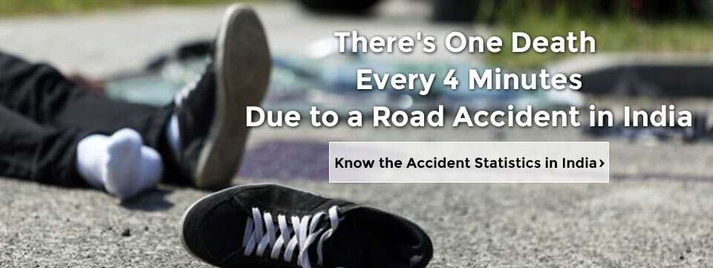

Slide 6
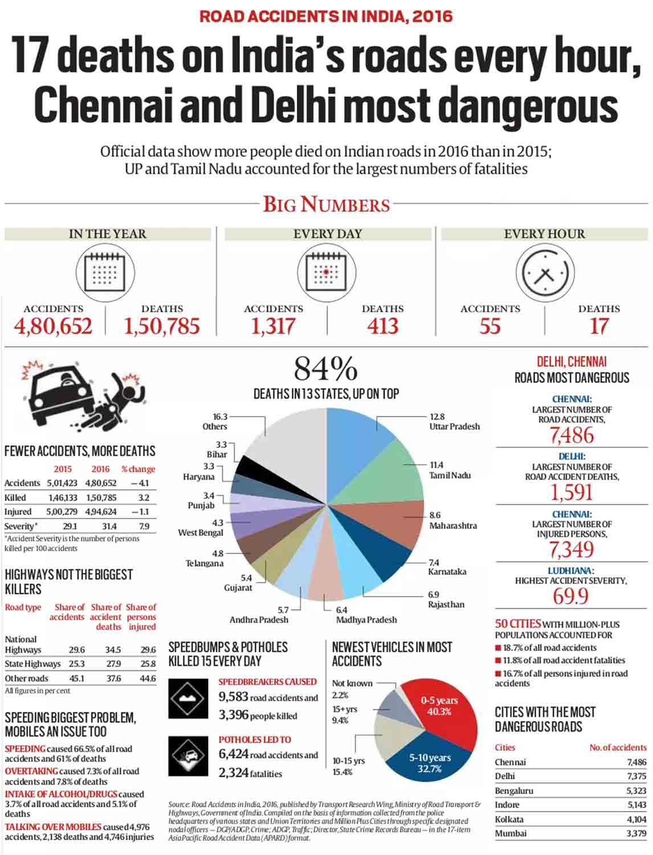
1 :

Slide 7
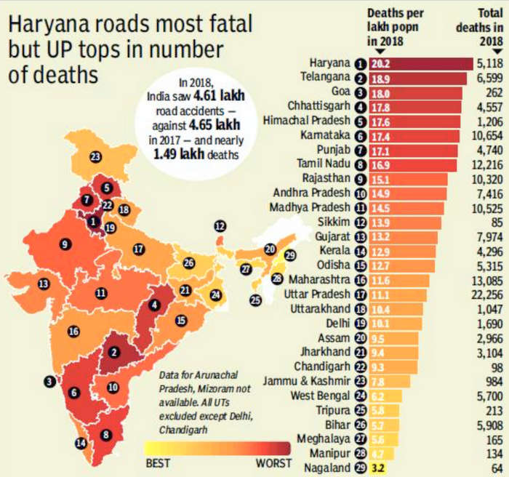
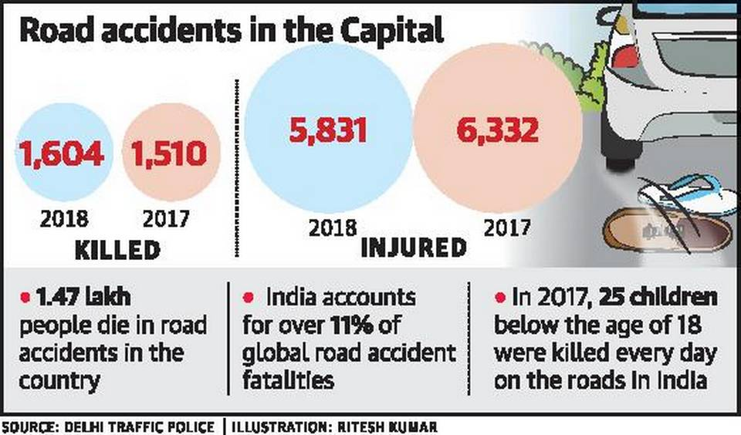

Slide 8
THE SOLUTION

Slide 9
Smart helmet
A pentronix product

Slide 10




Slide 11

The proposed helmet is equipped with
SLEEP DETECTION SYSTEM

Slide 12

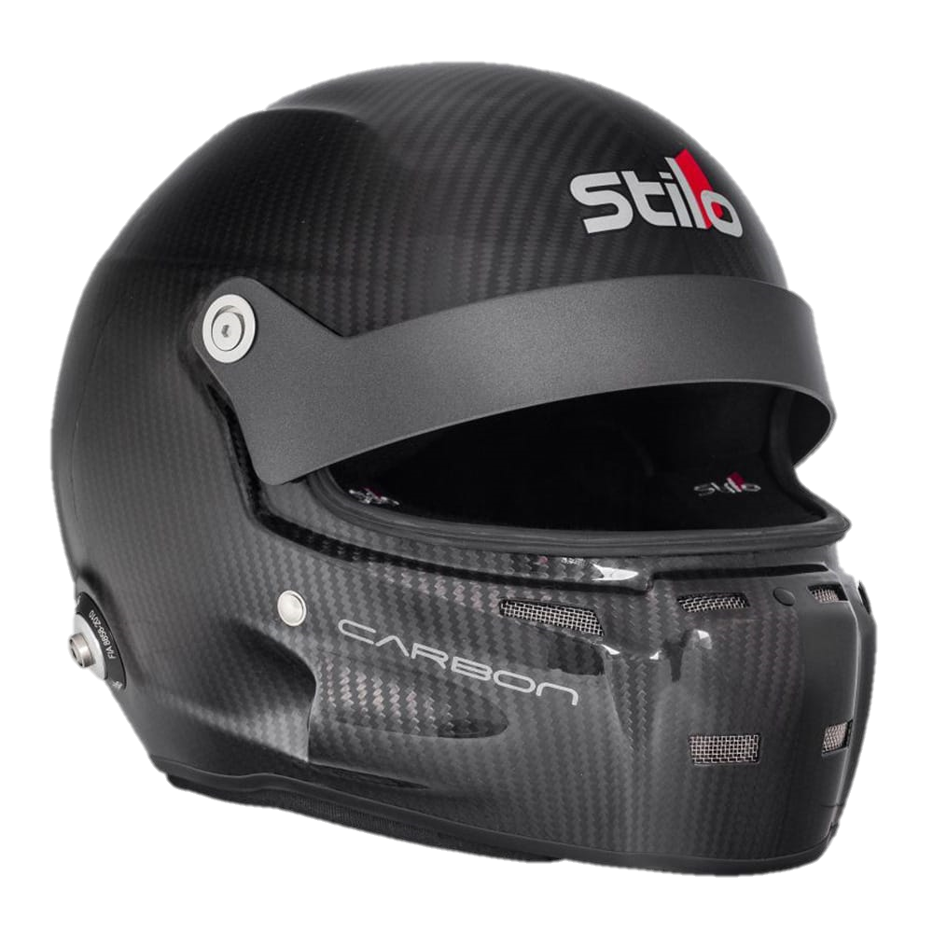

After sleep detection the helmet will try to wake the rider .

Slide 13


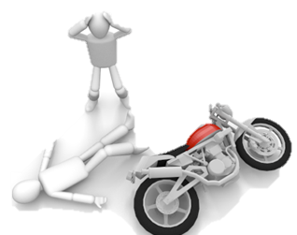
INSTANT MEDICAL SUPPORT

Slide 14
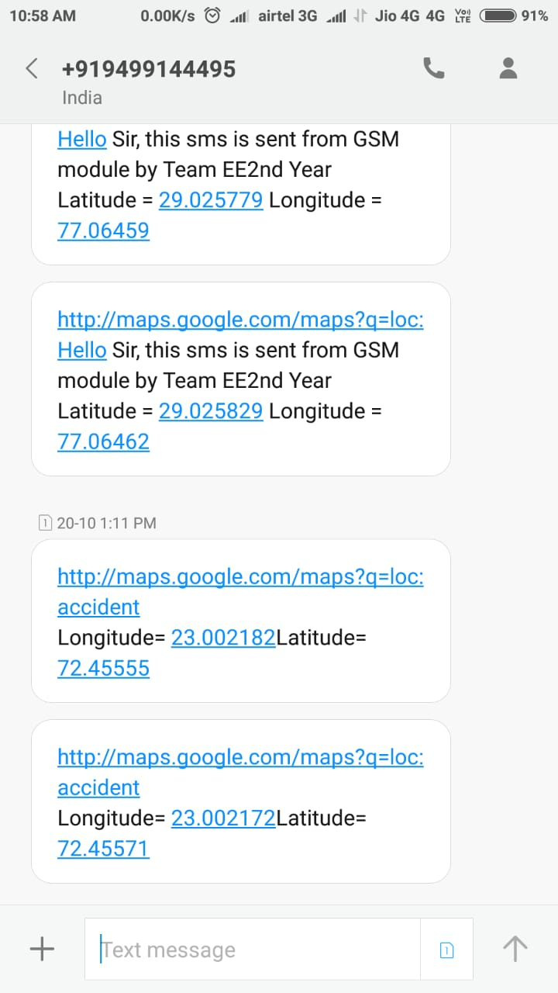
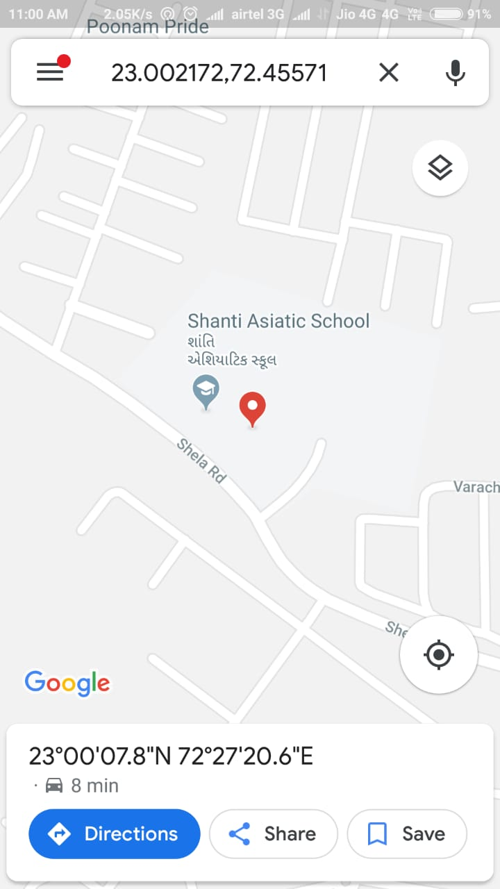

Slide 15
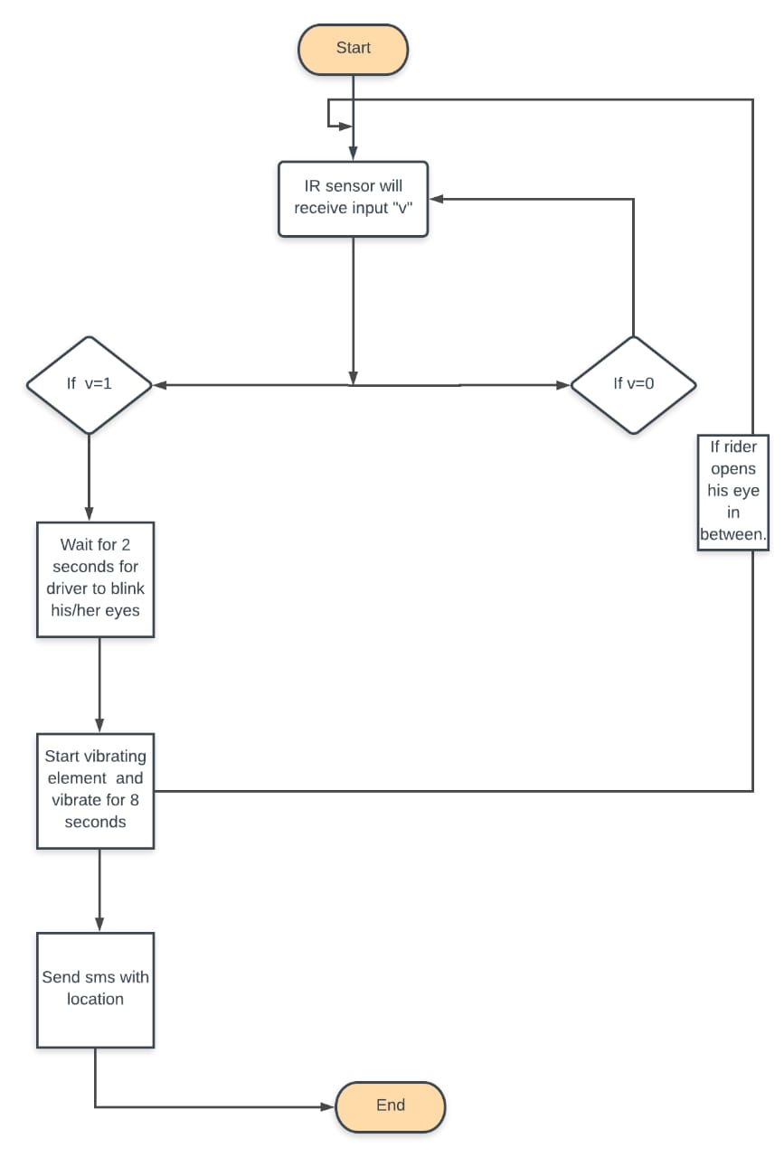
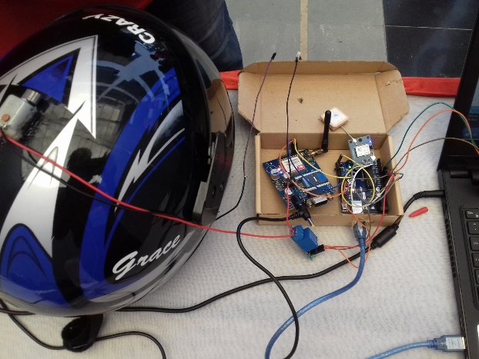

Slide 16

SIGNIFICANCE OF THIS RESEARCH AND PROJECT:
Will reduce accidents up to a considerable figure.
Will reduce death rates due to road accident to large extent.
Will act as an important reason to wear helmet.

Slide 17
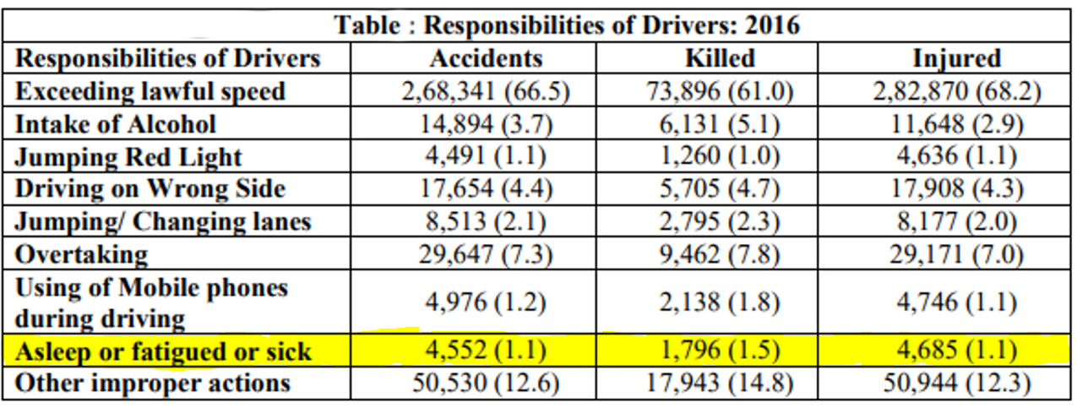
SOURCE: MINISTRY OF ROAD TRANSPORT AND HIGHWAYS TRANSPORT RESEARCH WING

